Slide 1







How to type in NEW data

Slide 2
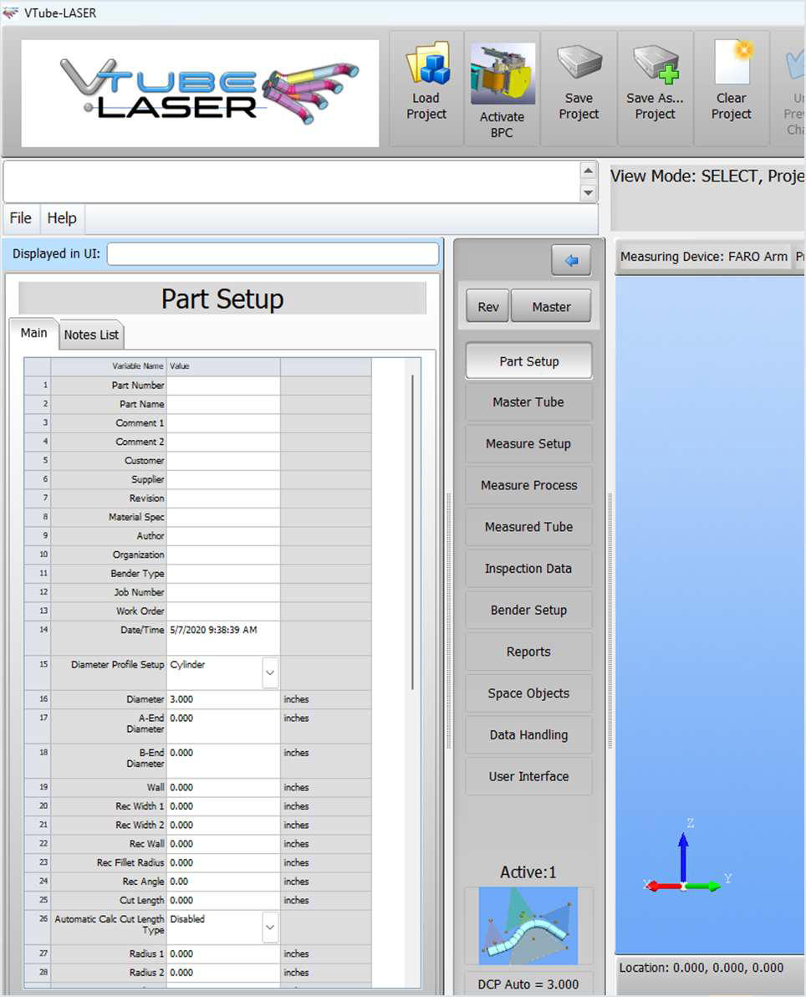
1-Clear project
2-Go to Part Setup
3-Enter values in row 1, 16, 27
Part Number
Diameter
Radius

Slide 3
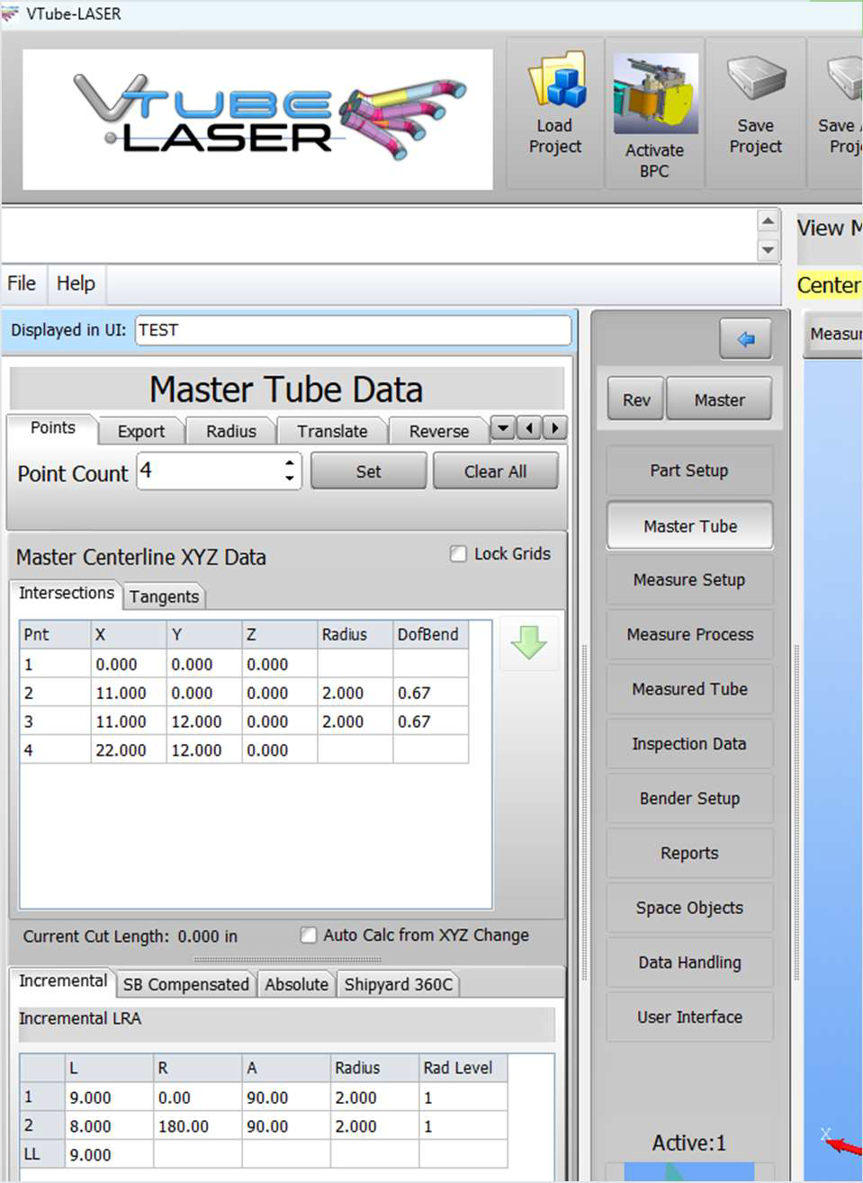
Under the Master Tube tab select:
1-Points
2-Enter the number of grid lines necessary
3-Hit Set
4-Enter XYZ or LRA data (if entering LRA enter
it as L, A, R)
5-Enter all of X then Y then Z using the ENTER
key on the keyboard

Slide 4
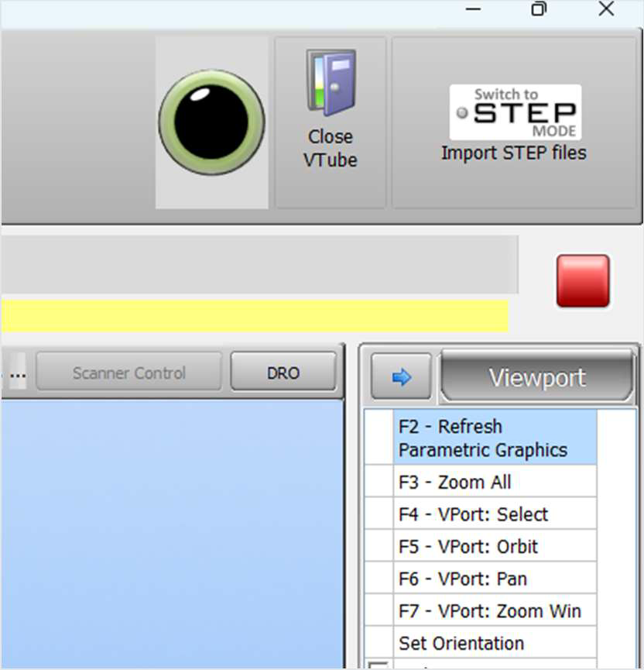
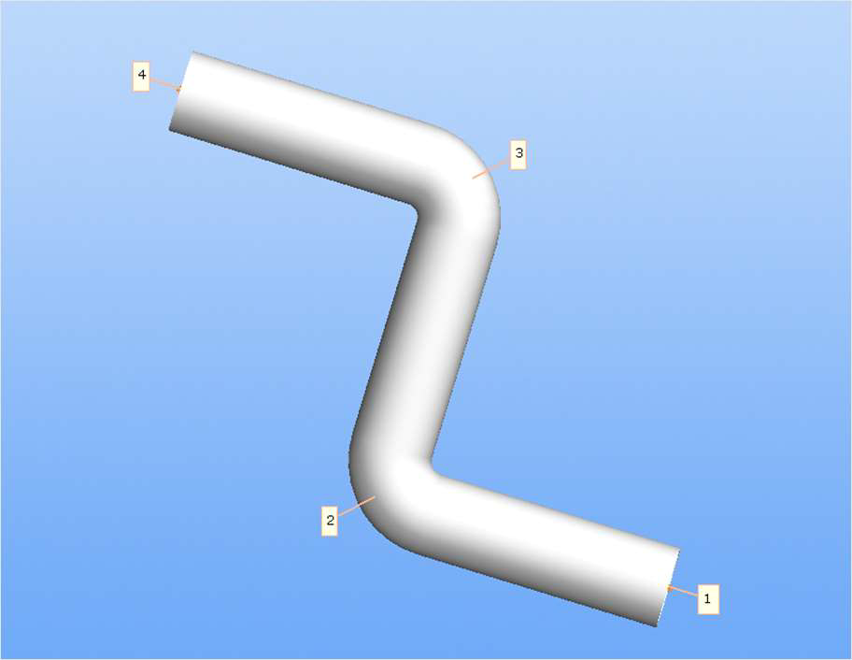
1-Press F2 to draw the tube
2-Press F3 to bring it into focus

Slide 5
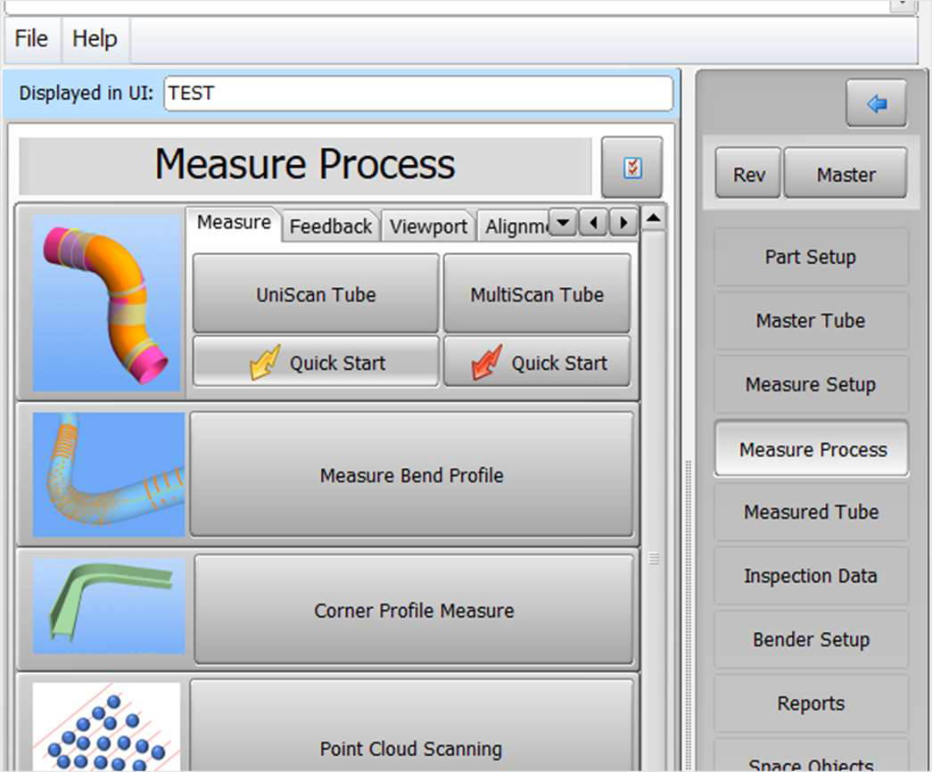
Now you are ready to measure!
1-Go to Measure Process
2-Quick Start

